Slide 1

Session 09
Packaging and Deploying

Slide 2
Objectives
Packaging and Deploying
Modes of Packaging
Deploying Application
Installation Editors
ClickOnce Deployment

Slide 3
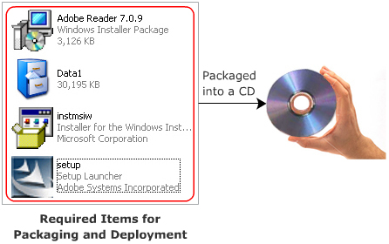
Packaging and Deploying
Packaging is a process of integrating all the files that make up an application and are required for installing and executing the application.
Deploying is a process of distributing the application so that it can be installed on the user’s computer.

Slide 4
The steps involved in the packaging process
Determine the Files You Want to Distribute
Create Dependency Files for Application’s Components
Determine Where to Install Files on the User’s Computer
Create Your Package

Slide 5
Deployment
Deployment allows you to distribute your application once it is built. These applications are installed on the target computer. Wherever you deploy an application, it is deployed in the form of assemblies. You can deploy an assembly as DLL or EXE files. There are many methods of deploying assemblies.
XCOPY
GACUTIL.exe

Slide 6
Deployment Features
No-impact Applications
Private Components by Default
Integration with Microsoft Windows Installer
Enterprise Deployment
ClickOnce Deployment

Slide 7
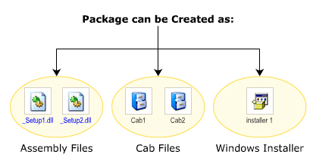
Ways of Packaging an Application
Packaging an application involves integrating all the necessary files of the application into a single package. You can package an application in three ways are:

Slide 8
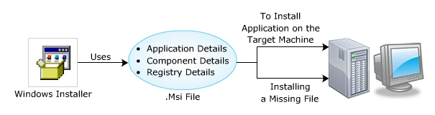
Installer Files
Windows Installer uses .msi file, which is a file format of a package. This .msi file contains information about the application and its installion.

Slide 9
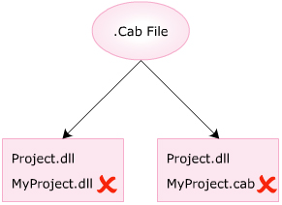
Cab File Project
A .cab file is a cabinet file, which is used to download components using a Web browser or using a removable media. It is similar to a zip file that compresses multiple files into an easily accessible and installable package.
Restrictions
Only a single assembly file can be packaged in a single .cab file.
Names of the assembly and the .cab file must match

Slide 10
Merge Modules
A merge module consists of different shared components, which are used by various application. It is a package that consists of component related registry entries and the setup logic.
A merge module consists of three main component
Merge Module Database: Consists of installation properties and setup logic
Merge Module Summary Information Stream Reference; provides details of the module.
MergeModule.CAB file. Consists of all the files required by the application related components.

Slide 11
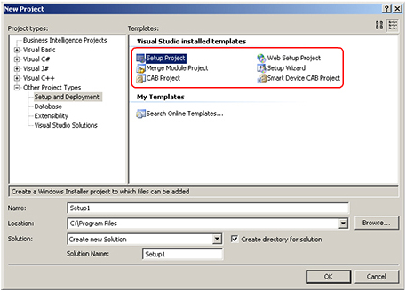
Deployment Project

Slide 12
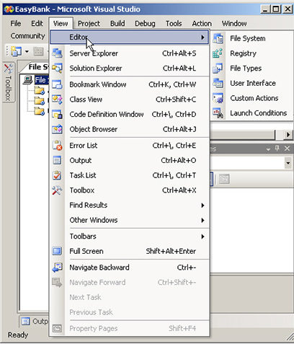
Adding Files to the Deployment Project

Slide 13
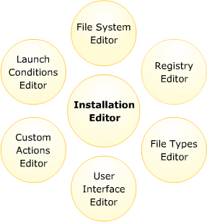
Installation Editors

Slide 14
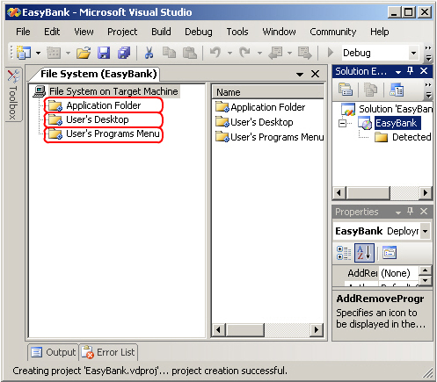
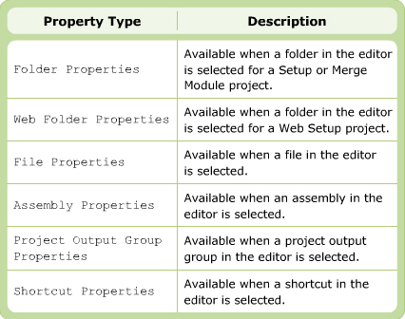
File System Editor

Slide 15
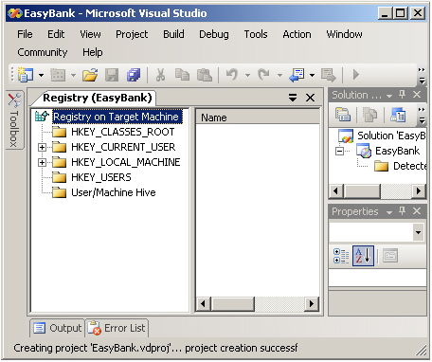
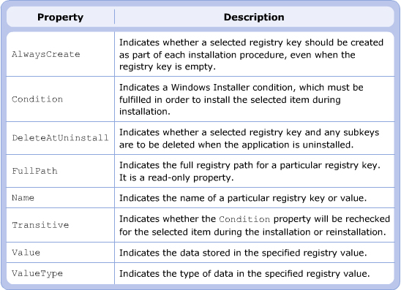
Registry Editor

Slide 16
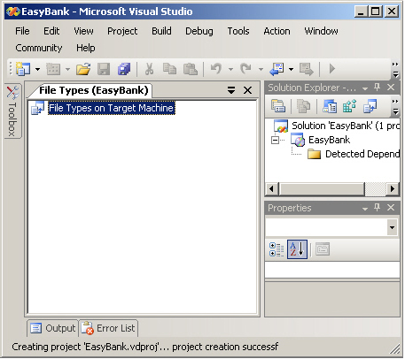
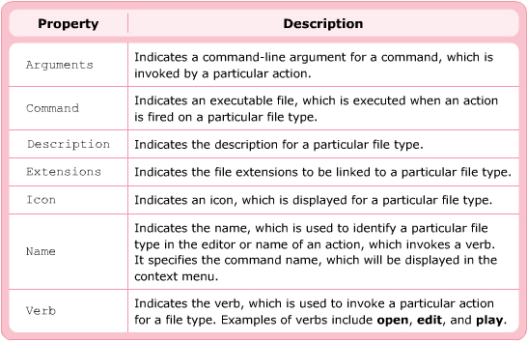
File Types Editor

Slide 17
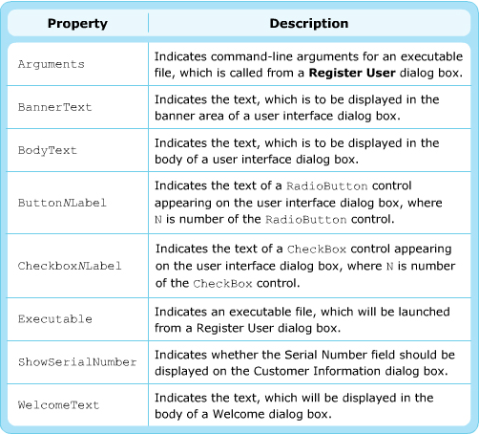
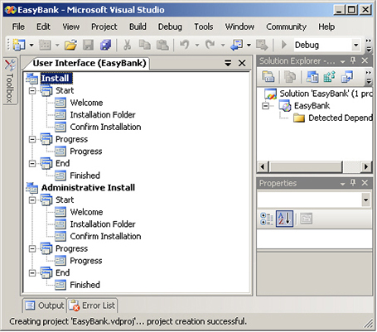
User Interface Editor

Slide 18
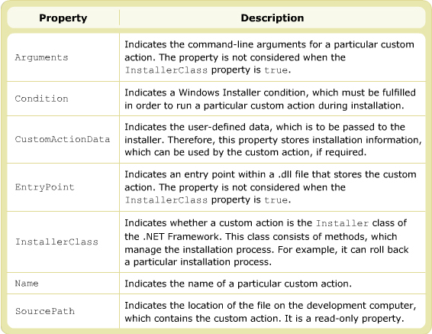
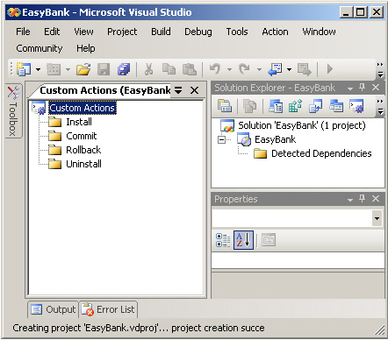
Custom Actions Editor

Slide 19
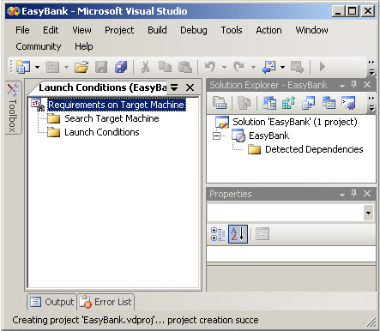
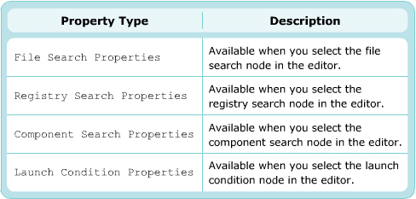
Launch Condition

Slide 20
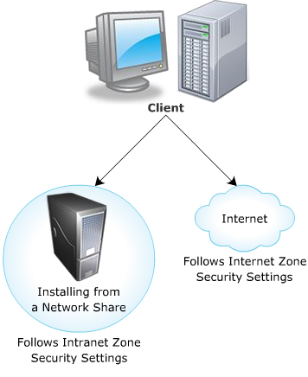
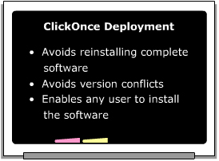
ClickOnce Deployment
ClickOnce deployment is a technology, which allows you to create auto-updating applications. The technology makes it easier to install and upgrade the software on the target machine.

Slide 21
Publishing the ClickOnce Application

Slide 22
Summary and Workshop
Packaging and Deploying
Modes of Packaging
Deploying Application
Installation Editors
ClickOnce Deployment

Slide 23

THANKS FOR WATCHING !

